Slide 1

ICT Learning Centre @ UL - Python and ML Foundations
ML – Data Visualisation

Slide 2


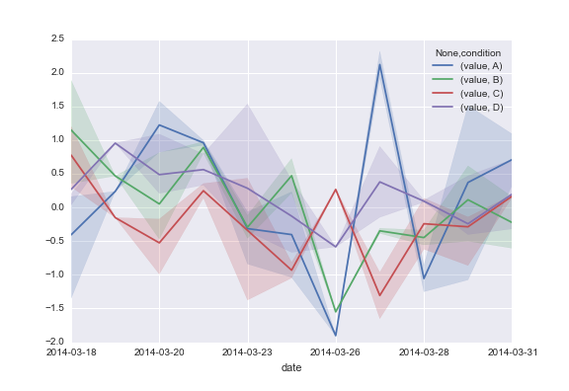
Data Visualisation
Finding the story in your data

Slide 3

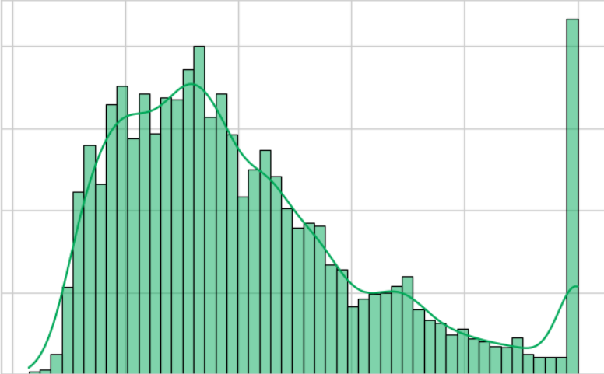
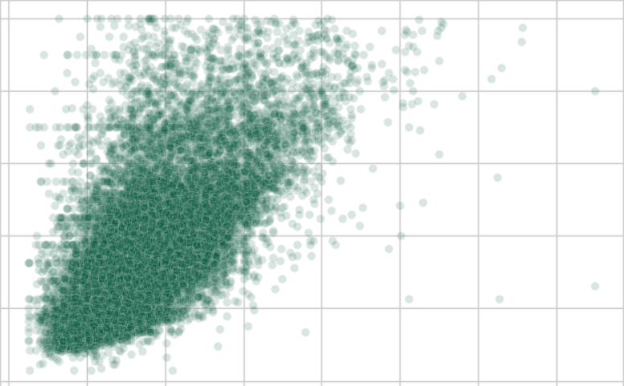
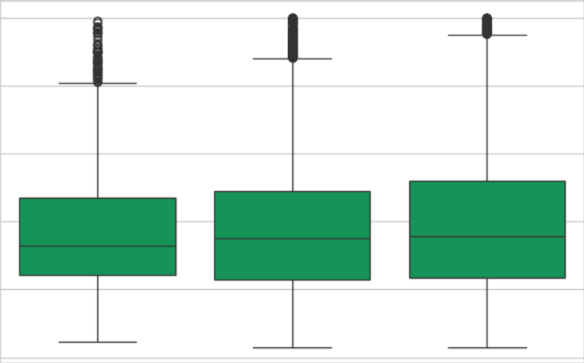
Why Visualise?
Visuals help us instantly find insights
Distribution & Skew
Patterns & Relationships
Outliers & Anomalies
It's the first and most important step in any data project.

Slide 4





Our Toolkit
Pandas: for loading and transforming data
Matplotlib: the “foundation” of plotting and provides full control
Seaborn: Built on matplotlib; creates beautiful statistical plots with less code

Slide 5
Matplotlib
Foundation of plotting in Python

Slide 6
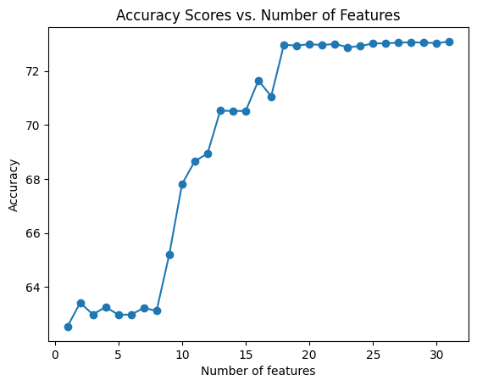
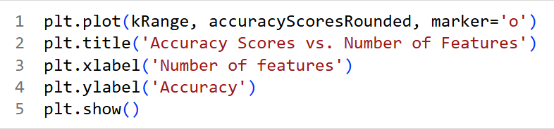
Matplotlib
Detailed, low-level control over every part of your figure.
Used via the pyplot interface, imported as plt (by convention)
It is "stateful“. You build a plot layer by layer.

Slide 12
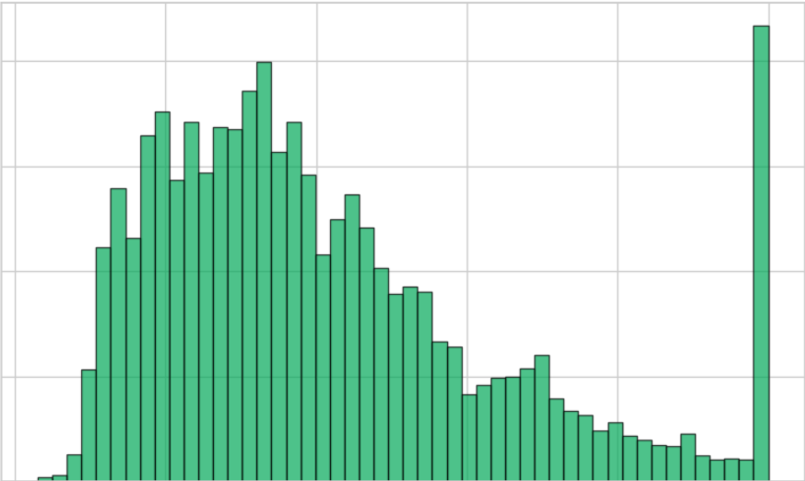
Histogram
How is the data spread out?
Helps to understand distribution and frequency of a single numerical variable.

Slide 25
Scatterplot
How are two variables related to each other?
Helps to find the relationship between two numerical variables.

Slide 30
Seaborn
High-level plotting

Slide 31
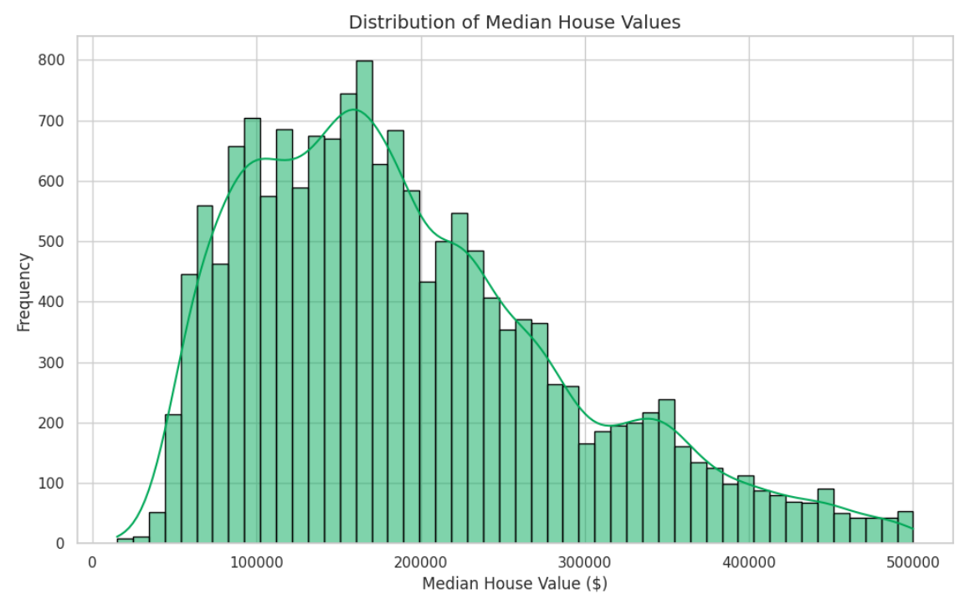
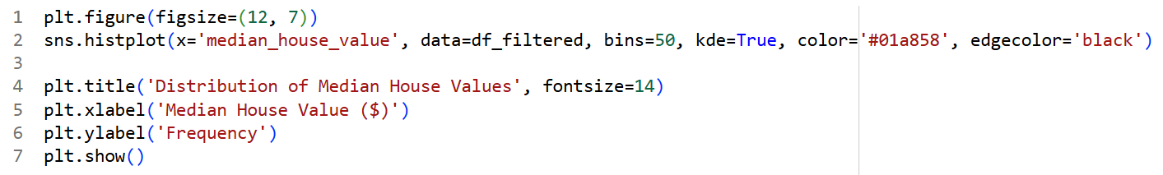
Seaborn
Built on top of Matplotlib and makes complex statistical plots simple.
It's "DataFrame-aware“.
plt.hist(df['col'])
It's "DataFrame-aware“.
sns.histplot(x=’col1’, df=df_name)

Slide 32

Recap: Feature Engineering
Using existing features to create new features.
Critical data science task
Example:
Objective - compare prices for 'New' vs 'Old’.
Categorise data into 3 new classes: 'New', 'Established', and 'Historic’ using ‘housing_median_age’ feature.

Slide 33
() ???

Slide 34
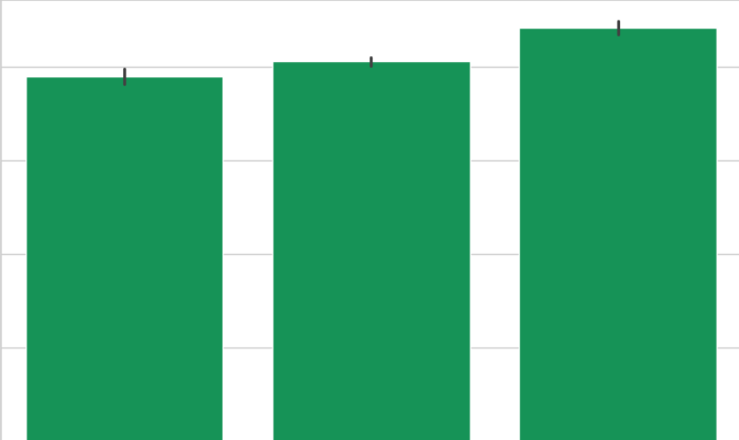
Bar Plot
How do the new house age groups compare?
Helps to compare frequencies/counts of categorical variables.
Seaborn’s advantage: automatically groups data.

Slide 39
Box Plot
Shows the spread and centre of a dataset using five key numbers: minimum, first quartile (Q1), median (Q2), third quartile (Q3), and maximum
Length of the box and whiskers indicate data spread
Dots outside the whiskers indicate outliers
Inter-Quartile Range (IQR) = Q3 - Q1

Slide 44
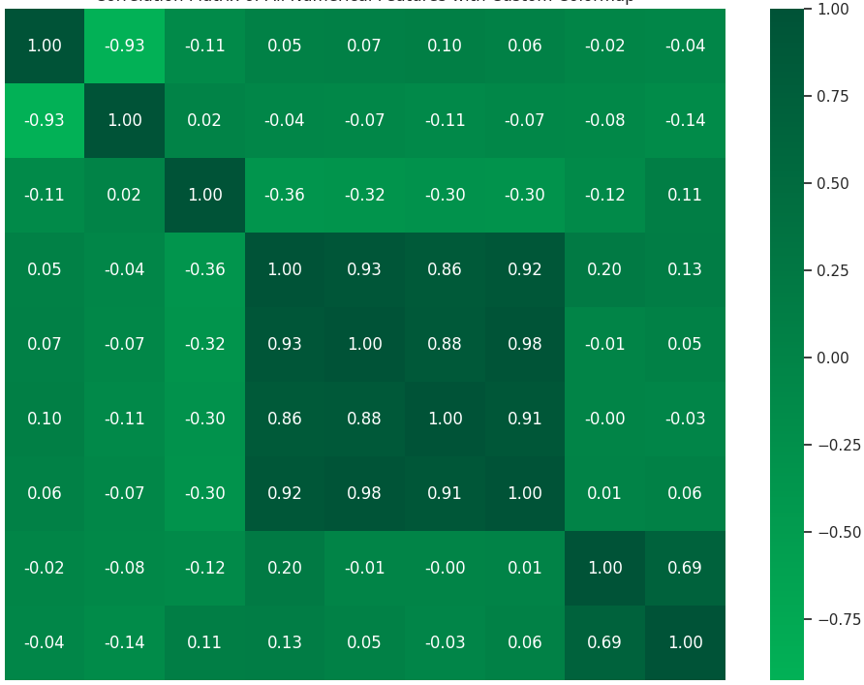
Heatmap
What are the strongest patterns in the entire dataset?
Visualises a correlation matrix

Slide 50
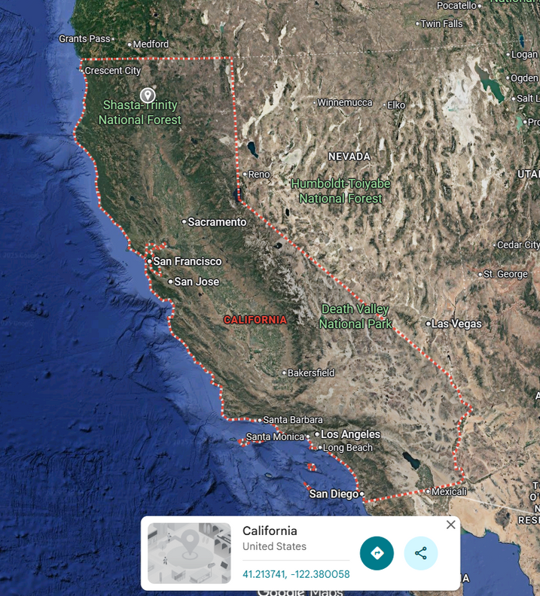



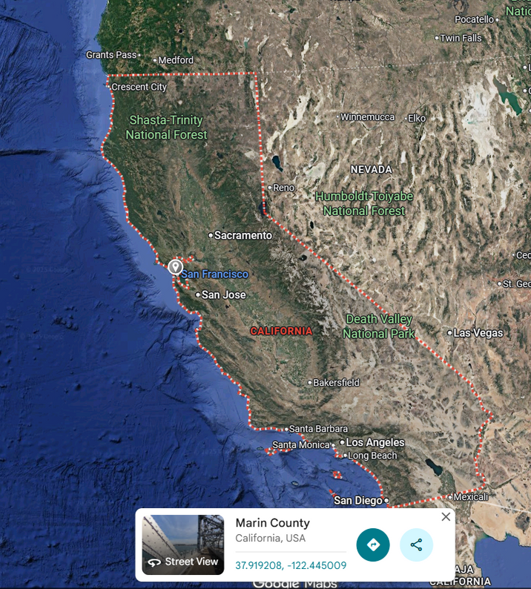

Slide 51
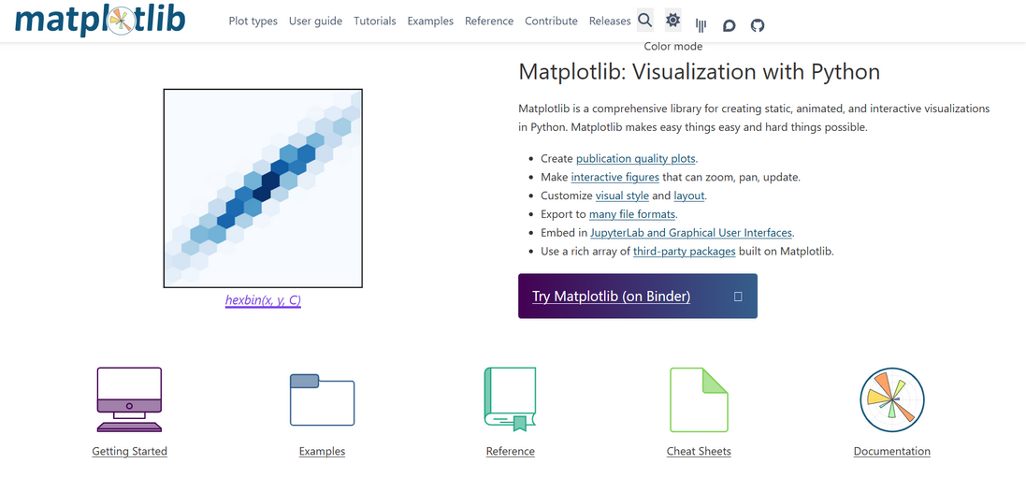
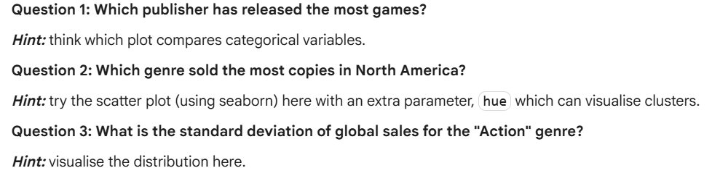
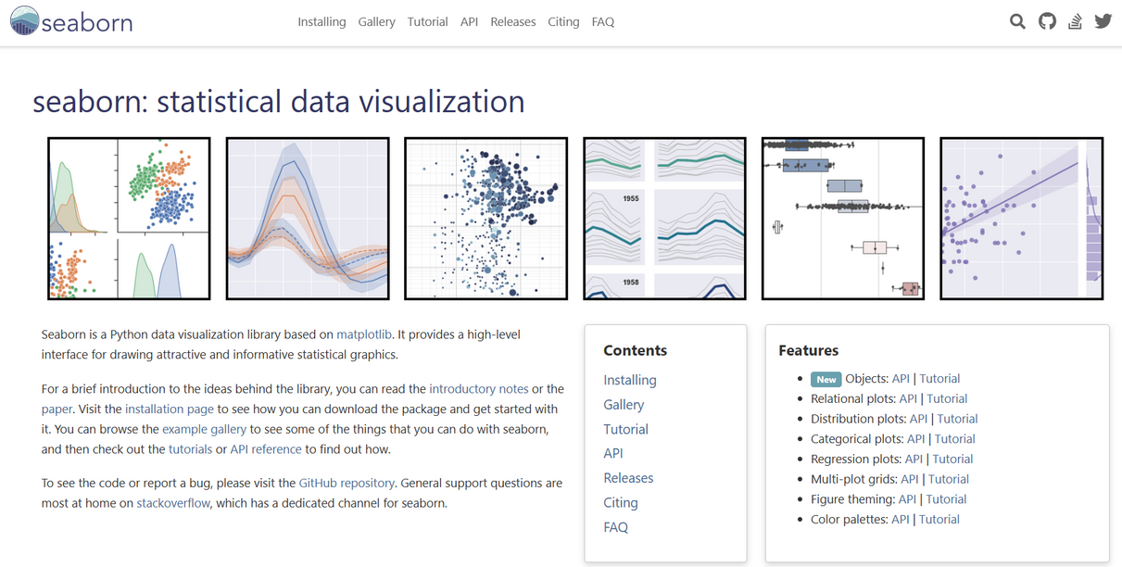
Practice Question
https://matplotlib.org/
Visualise video game sales data from last week’s challenge question
Answer the three analytical questions, but with visual evidence.
https://seaborn.pydata.org/

Slide 52

ICT Learning Centre,
CS1-046,
CSIS Building,
University of Limerick,
http://ictlc.ul.ie/contactus
Thank you

